Slide 1
Master-Thesis Methodical Approach for Analyzing Process Parameters and Optimizing Boundary Conditions in Mutli-Axis Robot Programs
Status Update: Week 07 (17 weeks left)
13.11.2023 – 19.11.2023
Jan Nalivaika

Slide 2
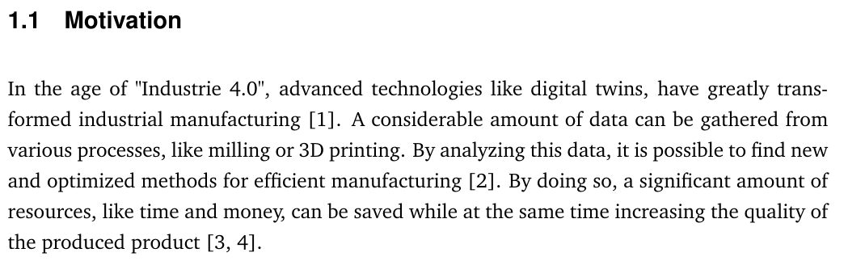
To-Do
- Stand der Technik (an Ludwig) am besten heute
- Wichtige Prozess Parameter sortieren
- Nur wichtiges validieren
- Quellen nach Nummer sortieren
- Nächster Termin: 17.11.2023 wie geplant
- 24.11. ohne Ludwig -> kein Termin
Wichtiger Punkt für Methode:
Normieren? Skalierung? Für „Local Score“ Berechnung (ML for best case calculations – Oultook?)

Slide 3
State of the Art Questions
Continuous-path mode ???
Changes: -
-
-
-
G-Code ??
Add / No Add

Slide 4
Process Parameters
Constraints to the toolpath
- Tool orientation (rotation around C)
- Robot configuration (joint 3, joint 5 and the overhead) [“J3- J5+ OH-“] {Area of solution}
- Auxiliary axes (Rotor Tilt Table)
Avoiding collisions
Avoiding motion exceeding or close to the motion limits of each joint
Avoiding excessive axes acceleration, velocity, and direction changes
Orient the tool or workpiece such that cables are optimal (laser fibres, welding wire and filament extrusion)
Avoid poses, which are near singularities

Slide 5
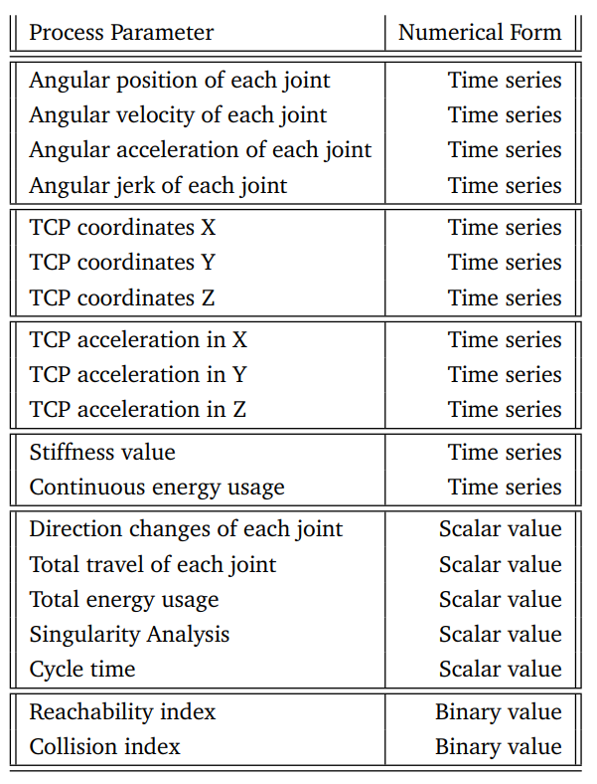
Moving near motion limits
Exceeding motion limits
Maximum joint velocity / smoothness of the velocity profile
Moving in rigid poses
Number of direction changes in all joints
Localized wear
Predicted energy consumption Proximity to singularity poses
Collisions
(Near) vertical material deposition
Risk of cable entanglement

Slide 6
Sort by VIP
Angular position of each joint
Angular velocity of each joint
Angular acceleration of each
Angular jerk of each joint
Direction changes of each joint (same end-position: LVL 2 implem.)
Total travel of each joint
TCP coordinates (X-Y-Z)
TCP velocity in (X-Y-Z)
TCP acceleration in (X-Y-Z)
Continuous energy usage
Total energy usage
(Near) Vertical material deposition
Reachability index (Cable entanglement) (Kabelvektor zur banane)
Singularity Analysis (J5 Gelenk)
Outlook: -> Stiffness value
-> Cycle time
Collision index

Slide 7
NX process
NX Einarbeitung bis 1.12.2023
NX questions deadline 15.12.2023

Slide 8
Contact
Jan Nalivaika (TUM) Student Otto-Hahn-Ring 6
81739 Munich, Germany
Phone +49 163 7180148
E-mail jan.nalivaika.ext@siemens.com nalivaika@outlook.de
Marius Breuer (Siemens AG)
Supervisor Otto-Hahn-Ring 6
81739 Munich, Germany
Phone +49 (172) 8396287
E-mail marius.breuer@siemens.com
Ludwig Siebert (TUM-IBW)
Supervisor Boltzmannstr. 15
85748 Garching at Munich
Phone +49 (89) 289 – 15578
E-mail ludwig.siebert@iwb.tum.de

